Slide 1
HomeCookHub
Mary Meineke, Sarah Murdock, Preston Savey, John Thompson,

Slide 2
Who We Are
Group Members:
Mary Meineke
meinekme@mail.uc.edu
Sarah Murdock
murdocsg@mail.uc.edu
Preston Savey
saveypc@mail.uc.edu
John Thompson
thomp5je@mail.uc.edu
Project Advisor:
Dr. Jillian Aurisano
jillian.aurisano@uc.edu
Notes:
Everyone

Slide 3
Team Roles
Sarah: Frontend Development
Preston: Frontend Development
John: Backend Development
Mary: Backend Development
Notes:
Everyone

Slide 4
Project Abstract
HomeCookHub aspires to unify the fragmented world of online culinary resources into a singular, holistic platform. Our primary goal is to confront and simplify the multifaceted challenges encountered by home cooks. These range from planning varied and nutritious meals, maintaining organized grocery lists, customizing recipes to align with specific dietary restrictions, acquiring new culinary skills, to making environmentally conscious and sustainable decisions in the kitchen.
Notes:
Mary

Slide 5
Purpose and Goals
Project Purpose Statement:
HomeCookHub aims to consolidate various cooking tools into one platform, making the entire cooking process—from recipe discovery to meal planning to grocery list—more efficient and sustainable.
Project Goals:
Unified Platform: Create a one-stop solution for recipes, meal planning, and grocery list generation.
Community Interaction: Provide a space for users to share and learn from each other.
Notes:
John

Slide 6
User Stories
As a home cook with a busy schedule I would like to easily and efficiently plan meals and create grocery lists by utilizing the meal plan generator and automated grocery list generation features.
As a cook, I want to easily find new recipes that I am able to cook.
As a chef I would like to share my recipes.
Notes:
Mary

Slide 7
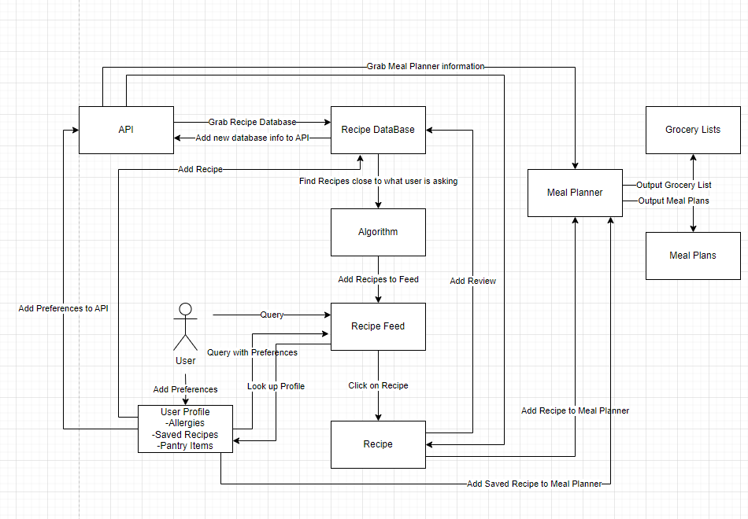
Design Diagrams
Notes:
John

Slide 8
Accomplishments
Frontend and Backend implementation on Web
Test Database
Search function and viewing recipes
Ability to add recipes that other users are able to search
Meal planning and grocery lists
Notes:
Mary

Slide 9
DEMO

Slide 10
Next Steps
Add reviews to recipes so that people can get user feedback and improve their recipes as well as help users choose more popular recipes
Add backend hosting so the entire website and all of its functionality can be viewed on our GitHub pages hosted url
Add filtering to the search function for user preferences such as dietary restrictions
Implement Mobile Integration
Notes:
John

Slide 11
Questions?

